Slide 1
Machine Learning
Final Project Milestone Presentation
第八組
數據所 RE6121011 徐仁瓏
數據所 RE6124019 吳明軒
數據所 RE6124027 曾文海
統計所 R26111010 黃韋皓

Slide 2
專案里程碑
文獻探討
10/30~11/03
欄位理解
11/04~11/08
資料分析與處理
11/09~11/13
雛型模型訓練與預測
11/14~11/21
資料前處理
11/22~11/28
特徵工程
11/29~12/05
模型訓練
12/06~12/12
集成學習
12/13~12/19

Slide 3
模型提升
Start
資料前處理
特徵工程
模型訓練
集成學習
觀察資料 & 分析資料:
了解欄位資料
檢查缺值、補值
檢查同時間重複
針對資料欄位做處理:
重要特徵搜尋
特徵融合
XGBoost
LightGBM
CatBoost
LSTM
Transformer
RNN
Bagging
Stacking
Average
End

Slide 4
文獻探討
Kaggle Notebook
KAGGLE Notebook
🥇🥇baseline lgb catboost🥇🥇 | Kaggle
生成特徵
(a-b)/(a+b)
(max-mid)/(mid-min)
使用LGB 訓練模型
使用CatBoost訓練模型
🏎️ High-Speed Predictions🌙 No-GPU | Kaggle
生成特徵
ask_size + bid_size
(ask_price + bid_price) / 2
(bid_size-ask_size)/(bid_size+ask_size)
bid_size / ask_size

Slide 5
原始特徵與生成特徵
stock_id | date_id | seconds_in_bucket | imbalance_size | imbalance_buy_sell_flag | reference_price | matched_size | far_price | near_price
bid_price | bid_size | ask_price | ask_size | wap | target | time_id | row_id
Imbalance_size | reference_price | Matched _size | far_ price | near_ price | bid_ price | ask_ price | wap | target
220 | 220 | 220 | 2894342 | 2857180 | 220 | 220 | 220 | 88
(a-b)/(a+b) 計算兩個特徵a和b之間的相對差異
(max-mid)/(mid-min) 這個特徵有助於捕捉特徵值在範圍內的變化程度
(ask_price + bid_price) / 2 計算買方價格與賣方價格平均
imbalance_size * imbalance_buy_sell_flag 給定正負值，得到買方多或賣方多
(*price(last) + *price(current))/2 這個特徵給定time series資訊

Slide 6



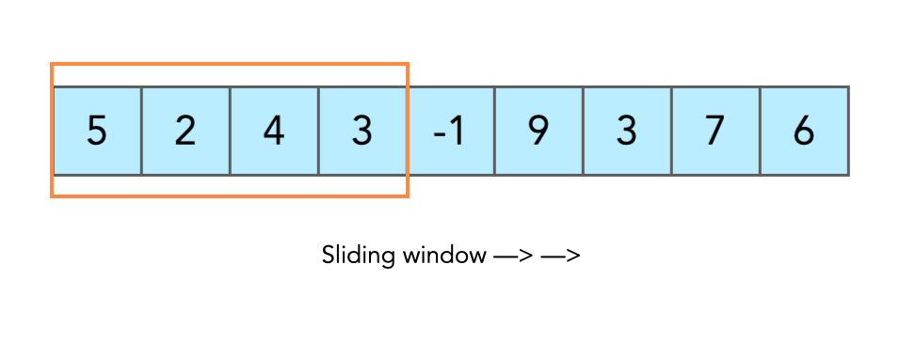
feature engineering
Imbalance Features:
Price
Size
Statistical Aggregation Features:
Mean, Median, Quantile, Mode, Standard, Skewness, Kurtosis
Time Series Features:

Slide 7
Model Training
Feature Selection:
CAT_model.feature_importance()
LGB_model.feature_importance()
Using Model:
Cat Boost Regressor、Light GBM (LGBM Regressor)
- Epochs = 100
- Early Stopping
- Evaluation Metric: MAE
- Save model
Cross Validation:
- 5-Fold

Slide 8
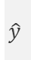
Ensemble Learning
Bagging:
Boosting:
Cat Boost Regressor、Light GBM (LGBM Regressor)
Stacking:
CAT
Test data
Average/
Voting
Predict
LGB
CAT
$$\hat{y}$$
Training data
LGB
Predict
LGB
$$\hat{y}$$

Slide 9
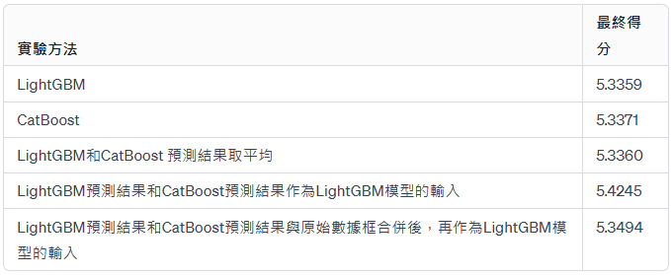
Result

Slide 10
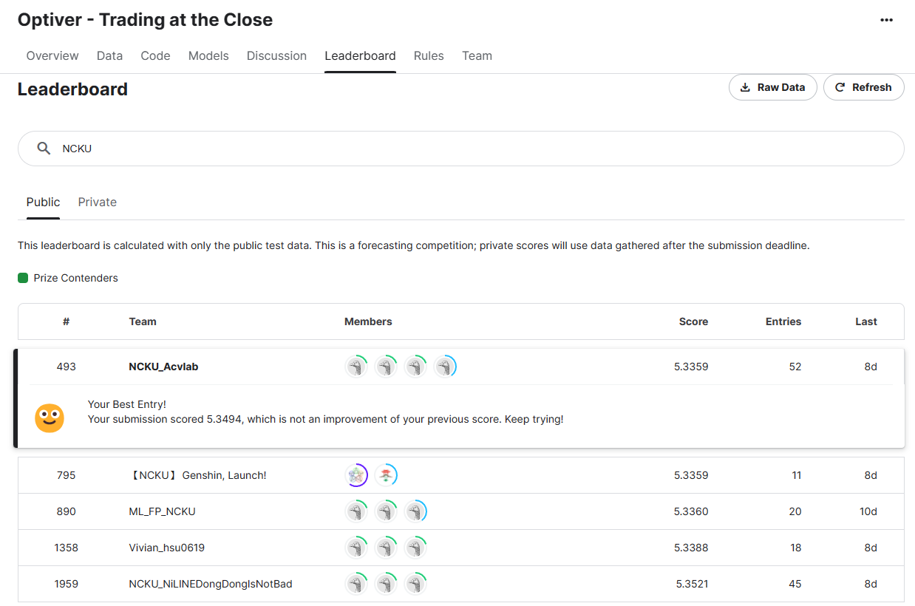
Result

Slide 11
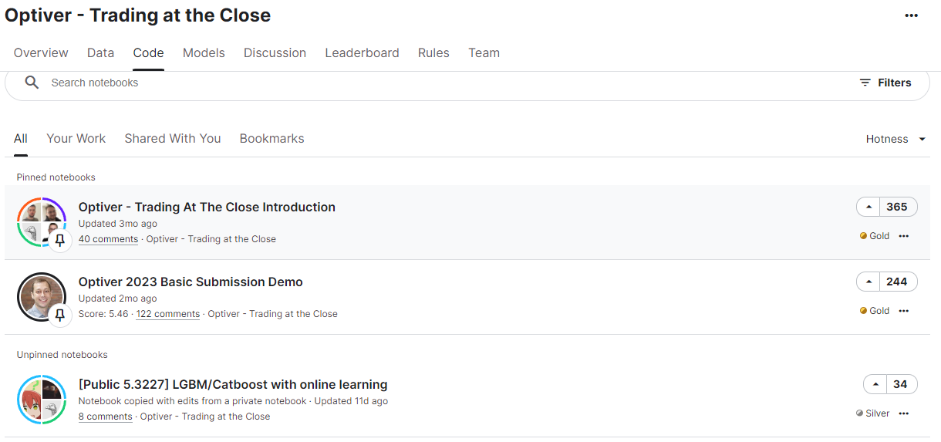
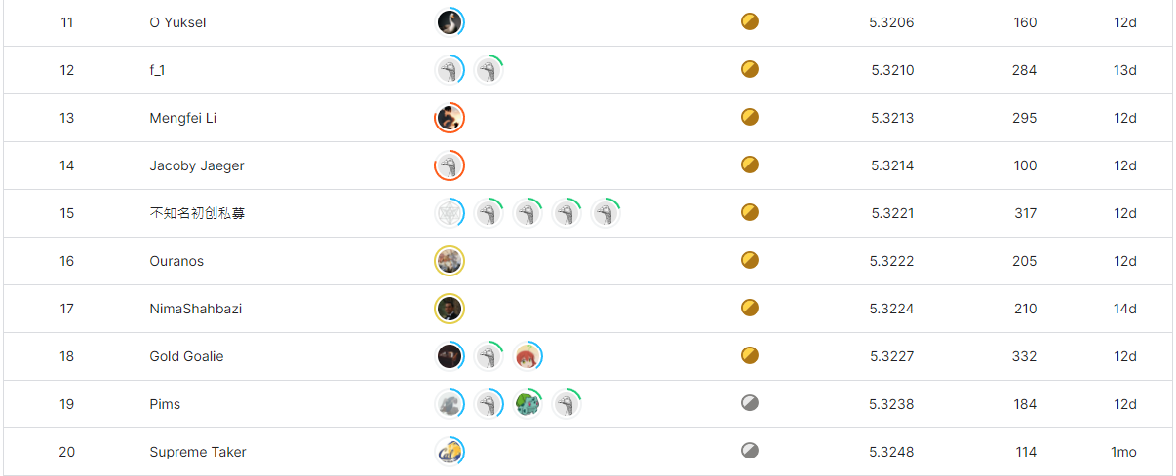
金牌作法

Slide 12
金牌作法
特徵工程
1. 不平衡特徵生成函數 (Imbalance Features Function)
- 功能： 生成不平衡特徵，突顯資料集中的不平衡情況。
- 目的： 提高模型對不平衡類別的敏感性，改善預測效能。
2. 其他特徵生成函數 (Other Features Function)
- 功能： 生成與時間和股票相關的特徵。
- 目的： 提供模型更多背景信息，增強對時間和股票市場的理解。
3. 最近天數特徵生成函數 (Last Days Features Function)
- 功能： 添加與最近幾天相關的額外特徵。
- 目的： 考慮最近的數據趨勢，提供模型更及時的信息，增進預測準確性。

Slide 13





金牌作法
一般做法
金牌做法
train
train
Data
Data
New Data
Prediction
New Data
Prediction

Slide 14
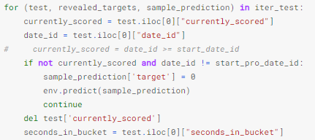
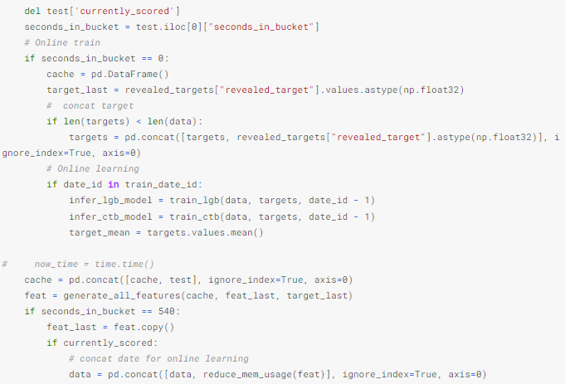
金牌作法
判斷481 date_id開始做retrain
將資料做retrain與新資料的concat

Slide 15
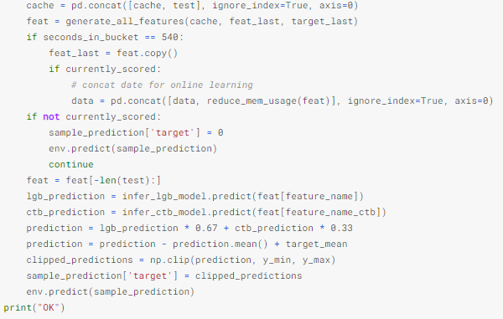
金牌作法
用retrain後的模型做infer

Slide 16
金牌作法
金牌作法優勢:
特徵工程提供模型更多背景信息、考慮最近的數據趨勢，提供模型更及時的信息。
模型預測後進行模型retrain保持模型準確度。
將前一天的資料加入資料集中。

Slide 17
Thanks!

Slide 18
Gallstones in Children
Here is where your presentation begins

Slide 19
Contents of this template
You can delete this slide when you’re done editing the presentation
Fonts | To view this template correctly in PowerPoint, download and install the fonts we used
Used and alternative resources | An assortment of graphic resources that are suitable for use in this presentation
Thanks slide | You must keep it so that proper credits for our design are given
Colors | All the colors used in this presentation
Icons and infographic resources | These can be used in the template, and their size and color can be edited
Editable presentation theme | You can edit the master slides easily. For more info, click here
For more info: Slidesgo | Blog | FAQs
You can visit our sister projects: Freepik | Flaticon | Storyset | Wepik | Videvo

Slide 20
Table of contents
01
02
03
04
05
06
The disease and its symptoms
People at risk
Risk factors
Available treatments
Disease prevention and control
Conclusion

Slide 21
01
The disease and its symptoms

Slide 22

Introduction to the disease
On the first part of the presentation, it’s important to give an overview of the disease you’re going to speak about. This helps your audience understand:
The context
The health risks
Likelihood of developing it
Prevalence

Slide 23
Who is at risk?
Genetic factors
Environmental factors
When a genetic factor puts a person at risk of developing an illness, it means that there is a hereditary component to that illness. This can be due to specific genetic mutations or variations that increase a person's susceptibility to developing the illness
When an environmental factor puts a person at risk of developing an illness, it means that exposure to certain substances, conditions or situations in the environment can increase the likelihood of developing that illness

Slide 24
Types of diseases
Types
Spread
Duration
Diseases vary based on transmission, like communicable (spreadable) and non-communicable (non-spreadable). They can also differ in duration: acute (short-term) or chronic (long-lasting)
Diseases spread as communicable or stem from genetics/lifestyle as non-communicable. Recognizing how diseases transmit informs preventive measures, while understanding non-communicable causes aids in lifestyle adjustments
Diseases range from acute, with sudden symptoms and short span, to chronic, with prolonged effects. Managing acute cases requires swift action, while chronic conditions demand continuous care to alleviate lasting impact

Slide 25
Four main types of treatments
Medical treatment
Behavioral therapy
This involves the use of medications, surgery, radiation therapy, chemotherapy or other medical procedures to treat a particular illness
Behavioral therapies involve various techniques that are used to treat mental health conditions, such as depression, anxiety and addiction
Alternative therapies
Lifestyle changes
Alternative therapies include a range of treatments that are not considered part of conventional medical practice
Lifestyle changes involve making modifications to an individual's diet, exercise habits or other behaviors

Slide 26
Risk factors
Age
Genetics
Lifestyle
Many diseases occur more frequently in certain age brackets
Some diseases have a hereditary component and can be passed down through families
Certain behaviors can increase the risk of developing
certain illnesses
Environment
Medical history
Gender
Exposure to certain substances in the environment can increase the risk of developing some diseases
A personal or family history of certain illnesses can increase the risk of developing related or similar conditions
Some illnesses are more common in one gender than the other

Slide 27
10,000
85%
1,000
Patients treated
Success rate
Suffered secondary effects

Slide 28
$1 billion
Investment in disease research is crucial for improving public health outcomes, advancing medicine and improving quality of life for patients, which in turn has the potential for significant economic growth and global health benefits

Slide 29
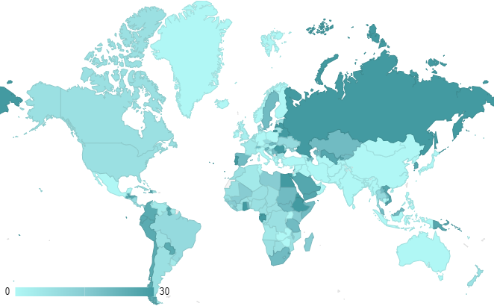
Disease prevalence
0-5% of the population in these regions are affected by the disease
6-14% of the population in these regions are affected by the disease
15-30% of the population in these regions are affected by the disease
Follow the link in the map to modify its data and then paste the new one here. For more info, click here

Slide 30
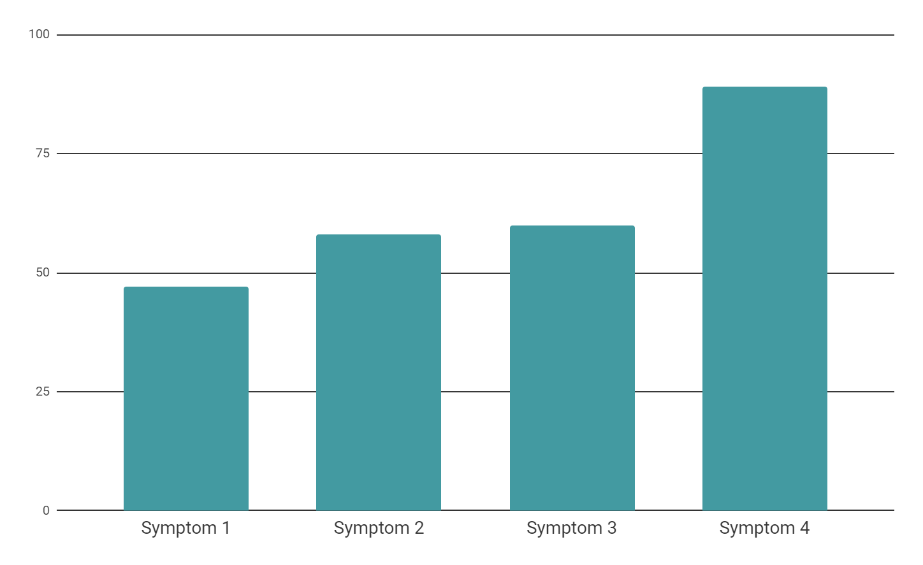
Symptoms and diagnosis
Most common symptoms
Use this slide to display the most common symptoms of the disease being discussed. Include a graph with a clear title and labels for each axis. You can also explain how the disease is diagnosed, including the types of tests or procedures used, to help your audience understand how it is identified and treated
Follow the link in the map to modify its data and then paste the new one here. For more info, click here

Slide 31
Risk factors and complications
Risk factors | Description | Prevalence | Contributing factors | Complications | Severity
Write the risk factors here | In this part, include a brief description | 80% of cases | Write the contributing factors here | In this part, write the complications of the disease | High
Write the risk factors here | In this part, include a brief description | 30% of cases | Write the contributing factors here | In this part, write the complications of the disease | Moderate
Write the risk factors here | In this part, include a brief description | 40% of cases | Write the contributing factors here | In this part, write the complications of the disease | High
Write the risk factors here | In this part, include a brief description | 10% of cases | Write the contributing factors here | In this part, write the complications of the disease | Moderate

Slide 32
Disease history
Discovery of the disease
Early research
First treatment
Milestone discoveries
Breakthrough treatment
Epidemic outbreak
Current research
Future directions

Slide 33
Diagnosis and treatment flowchart
Start
Patient symptoms
Diagnostic test
Diagnosis confirmed
Prescribe treatment
List the symptoms that the patient is experiencing:
Write the symptoms of the patient
Write the symptoms of the patient
Write the symptoms of the patient
List the diagnostic tests that were performed:
Write the diagnostic test performed
Write the diagnostic test performed
Write the diagnostic test performed
This step represents the confirmation or ruling out of a specific disease diagnosis based on the results of the
diagnostic tests
List the recommended treatment options
Write the
treatment options
Write the
treatment options
Write the
treatment options
End

Slide 34


Real life impact
A photo showcase can be a useful addition to any presentation, as it showcases the most human side of every subject

Slide 35
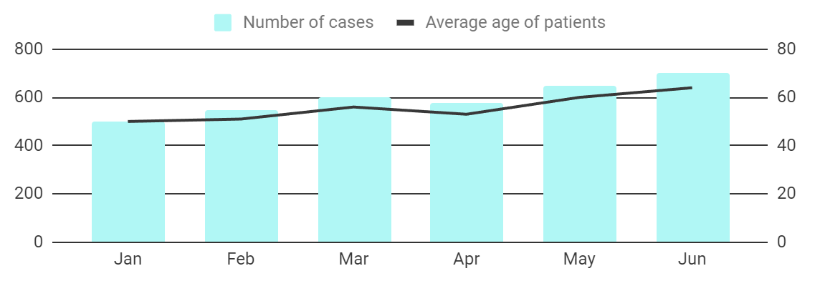
Disease management
Number of cases of the disease over time
Region | Number of cases | Percentage of cases
North | 1,000 | 20%
South | 2,500 | 50%
East | 1,200 | 24%
Describe the trend of the disease cases
over time
Provide key insights or observations about
the graph
Explain any significant changes or patterns in the graph
List the regions or areas that are relevant for
the disease
Enter the number of cases for each region, area or country
Describe any notable variations or trends among the regions
Provide additional details or observations about the table
Follow the link in the graph to modify its data and then paste the new one here. For more info, click here

Slide 36
Disease overview and conclusions
Information
Causes | Introduce in this section your specific information
Symptoms | Introduce in this section your specific information
Diagnosis | Introduce in this section your specific information
Treatment | Introduce in this section your specific information
Prevention | Introduce in this section your specific information
Key findings
Summarize the most important or relevant aspects of the disease
Use bullet points to present the key findings in a clear and organized manner
Conclusions
1
In this section, summarize the key findings from the disease study
2
Provide an overview of the implications for the current diagnosis and treatment plan

Slide 37
Thanks!
DO YOU HAVE ANY QUESTIONS?
youremail@freepik.com
+91 620 421 838
yourwebsite.com
Please keep this slide for attribution

Slide 38
Alternative resources
Here’s an assortment of alternative resources whose style fits the one of this template:

Slide 39
Resources
Did you like the resources on this template? Get them for free at our other websites:
PHOTOS:
Little girl suffering from stomach ache lying on gray sofa
Medical teleconsultation for sick patient at home
VECTORS:
Business strategy poster template
Business strategy square flyer
Business strategy youtube cover

Slide 40
Instructions for use
If you have a free account, in order to use this template, you must credit Slidesgo by keeping the Thanks slide. Please refer to the next slide to read the instructions for premium users.
As a Free user, you are allowed to:
Modify this template.
Use it for both personal and commercial projects.
You are not allowed to:
Sublicense, sell or rent any of Slidesgo Content (or a modified version of Slidesgo Content).
Distribute Slidesgo Content unless it has been expressly authorized by Slidesgo.
Include Slidesgo Content in an online or offline database or file.
Offer Slidesgo templates (or modified versions of Slidesgo templates) for download.
Acquire the copyright of Slidesgo Content.
For more information about editing slides, please read our FAQs or visit our blog:
https://slidesgo.com/faqs and https://slidesgo.com/slidesgo-school

Slide 41
Instructions for use (premium users)
As a Premium user, you can use this template without attributing Slidesgo or keeping the "Thanks" slide.
You are allowed to:
Modify this template.
Use it for both personal and commercial purposes.
Hide or delete the “Thanks” slide and the mention to Slidesgo in the credits.
Share this template in an editable format with people who are not part of your team.
You are not allowed to:
Sublicense, sell or rent this Slidesgo Template (or a modified version of this Slidesgo Template).
Distribute this Slidesgo Template (or a modified version of this Slidesgo Template) or include it in a database or in any other product or service that offers downloadable images, icons or presentations that may be subject to distribution or resale.
Use any of the elements that are part of this Slidesgo Template in an isolated and separated way from this Template.
Register any of the elements that are part of this template as a trademark or logo, or register it as a work in an intellectual property registry or similar.
For more information about editing slides, please read our FAQs or visit our blog:
https://slidesgo.com/faqs and https://slidesgo.com/slidesgo-school

Slide 42
Fonts & colors used
This presentation has been made using the following fonts:
Bebas Neue
(https://fonts.google.com/specimen/Bebas+Neue)
Didact Gothic
(https://fonts.google.com/specimen/Didact+Gothic)
#383838
#ffffff
#b0f7f5
#88ccd2
#439aa1
#141414

Slide 43





Storyset
Create your Story with our illustrated concepts. Choose the style you like the most, edit its colors, pick the background and layers you want to show and bring them to life with the animator panel! It will boost your presentation. Check out how it works.
Pana
Amico
Bro
Rafiki
Cuate

Slide 44
Use our editable graphic resources...
You can easily resize these resources without losing quality. To change the color, just ungroup the resource and click on the object you want to change. Then, click on the paint bucket and select the color you want. Group the resource again when you’re done. You can also look for more infographics on Slidesgo.

Slide 47
JANUARY
FEBRUARY
MARCH
APRIL
MAY
JUNE
PHASE 1
Task 1
Task 2
PHASE 2
Task 1
Task 2
JANUARY
FEBRUARY
MARCH
APRIL
PHASE 1
Task 1
Task 2

Slide 50
...and our sets of editable icons
You can resize these icons without losing quality.
You can change the stroke and fill color; just select the icon and click on the paint bucket/pen.
In Google Slides, you can also use Flaticon’s extension, allowing you to customize and add even more icons.

Slide 51
Educational Icons
Medical Icons

Slide 52
Business Icons
Teamwork Icons

Slide 53
Help & Support Icons
Avatar Icons

Slide 54
Creative Process Icons
Performing Arts Icons

Slide 55
Nature Icons

Slide 56
SEO & Marketing Icons

Slide 57


